Slide 1
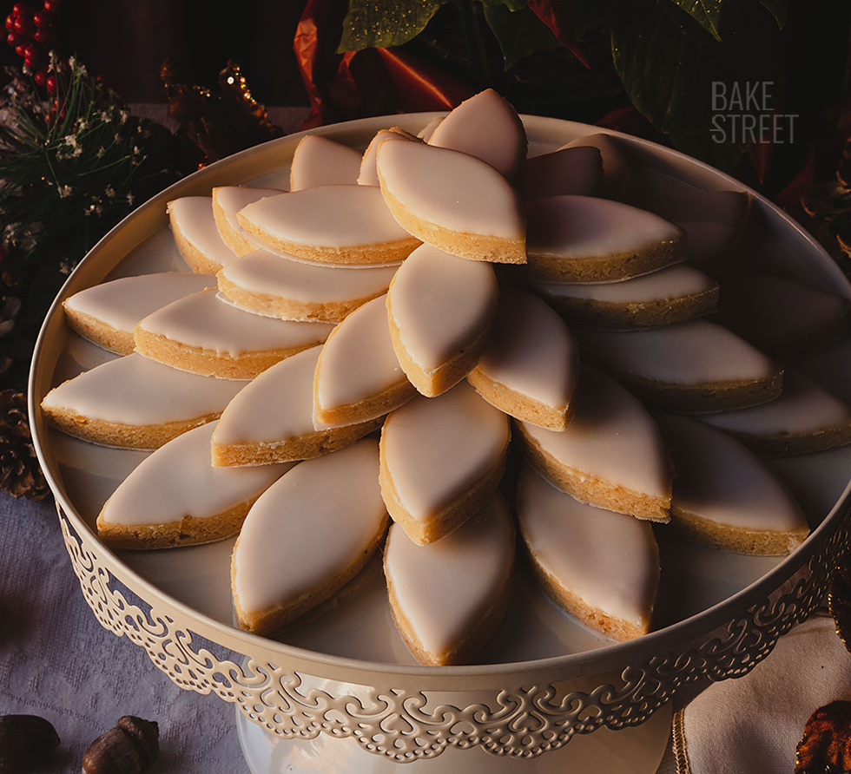
Bonus: Calisson Tiling

Slide 2
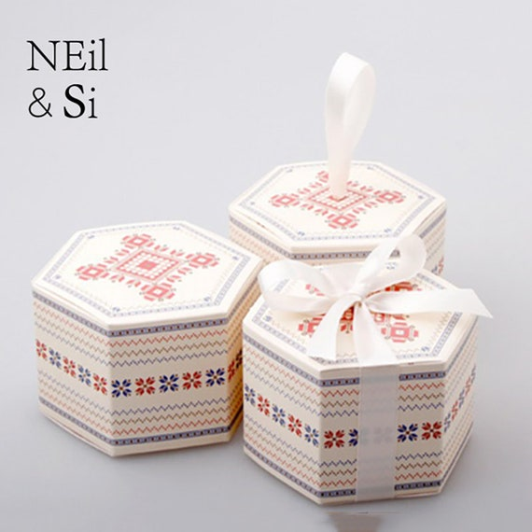
Calissons
A calisson is a diamond-shaped cookie popular in France
Traditionally sold in a hexagonal box
To save space, the packers need to pack as many diamonds into each hexagon as possible.

Slide 3
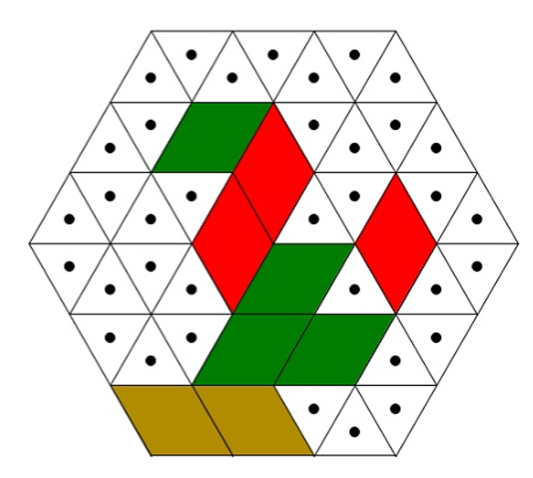
Calisson Tiling
If we perfectly tile our hexagonal box using calissons, every calisson we place will have one of three possible orientations.

Slide 4
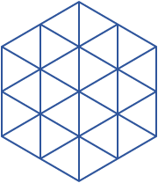
You Try It
Tile this (smaller) box with calissons.
You will need 12 calissons total.
How many calissons did you use in each orientation?
Upright: _______________
Right-Leaning: _______________
Left-Leaning: _______________

Slide 5
You Try It
Conjecture:
Every calisson tiling uses the same number of calissons in each of the three orientations.
(…but why would this have to be true?)
Tile this (smaller) box with calissons.
You will need 12 calissons total.
How many calissons did you use in each orientation?
Upright: _____4________
Right-Leaning: _____ 4 __________
Left-Leaning: ______ 4 _________

Slide 6
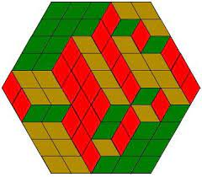
I’ll Try It
Here’s a tiling of a bigger hexagon, with calissons colored by orientation.
Notice anything?

Slide 7
Proof by Optical Illusion
Theorem:
Every calisson tiling uses the same number of calissons in each of the three orientations.
Proof:
Consider an arbitrary calisson tiling
When we color the calissons by tiling, we see a picture that looks like a 3d stack of boxes (!!)

Slide 8
Proof by Optical Illusion
Theorem:
Every calisson tiling uses the same number of calissons in each of the three orientations.
Proof:
Consider an arbitrary calisson tiling
When we color the calissons by tiling, we see a picture that looks like a 3d stack of boxes (!!)
Imagine rotating the 3d box stack so that we’re looking down on it from the top left. What do we see?

Slide 9
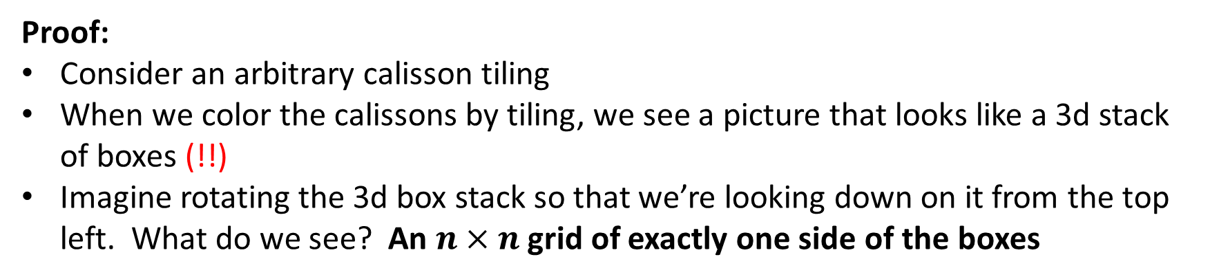
Proof by Optical Illusion
Theorem:
Every calisson tiling uses the same number of calissons in each of the three orientations.
Proof:
Consider an arbitrary calisson tiling
When we color the calissons by tiling, we see a picture that looks like a 3d stack of boxes (!!)
Imagine rotating the 3d box stack so that we’re looking down on it from the top left. What do we see? An $n×n$ grid of exactly one side of the boxes

Slide 10
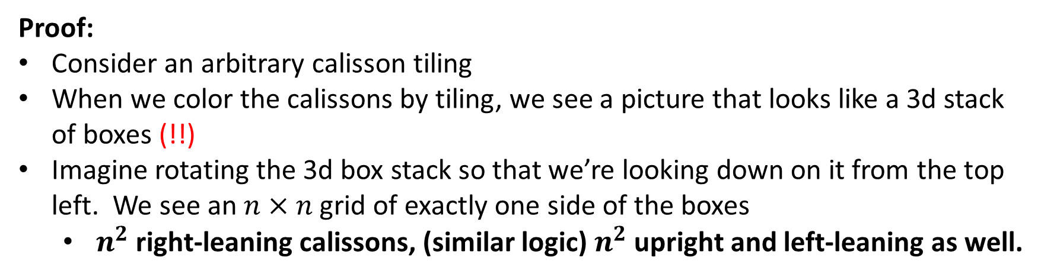
Proof by Optical Illusion
Theorem:
Every calisson tiling uses the same number of calissons in each of the three orientations.
Proof:
Consider an arbitrary calisson tiling
When we color the calissons by tiling, we see a picture that looks like a 3d stack of boxes (!!)
Imagine rotating the 3d box stack so that we’re looking down on it from the top left. We see an $n×n$ grid of exactly one side of the boxes
$n^{2}$ right-leaning calissons, (similar logic) $n^{2}$ upright and left-leaning as well.

Slide 11
Moral of the Story
Proofs contain two parts:
An insight: why is the proposition true?
And then a logical certificate: any correct insight down into a correct chain of low-level logic.
These logical certificates are cool because they can turn the process of insight-finding into formal math!
But the entire point of math+CS are the insights.

